Slide 1
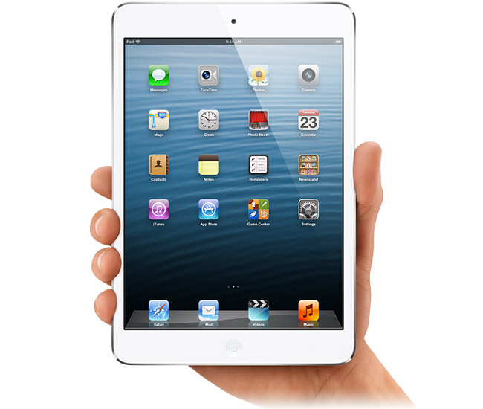
iPads in Education: Using iPad Computer Games as a Stimulus. Matt Patterson
Angry Birds
PicCollage
Temple Run 2
Socrative
Theme Park
Skitch
Minecraft
iMovie
‘iPad Games as a stimulus’ – M. Patterson

Slide 2
Angry Birds
Through playing the game, we have looked at:
Types of angles (Acute, Right & Obtuse).
Probability / Chance words.
Nets of 3D shapes
Measuring angles.
All areas identified as a class weakness through QCA analysis.
‘iPad Games as a stimulus’ – M. Patterson

Slide 3
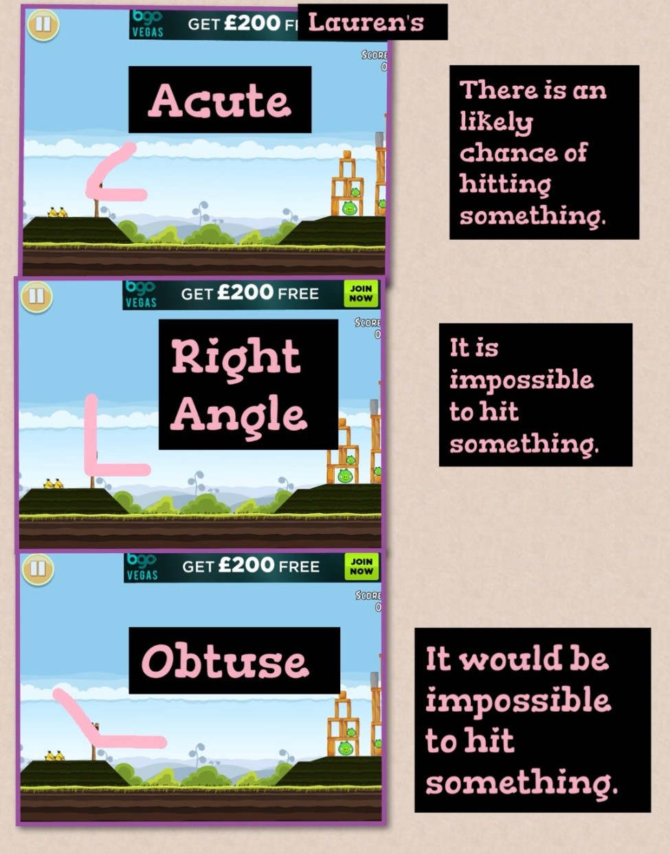
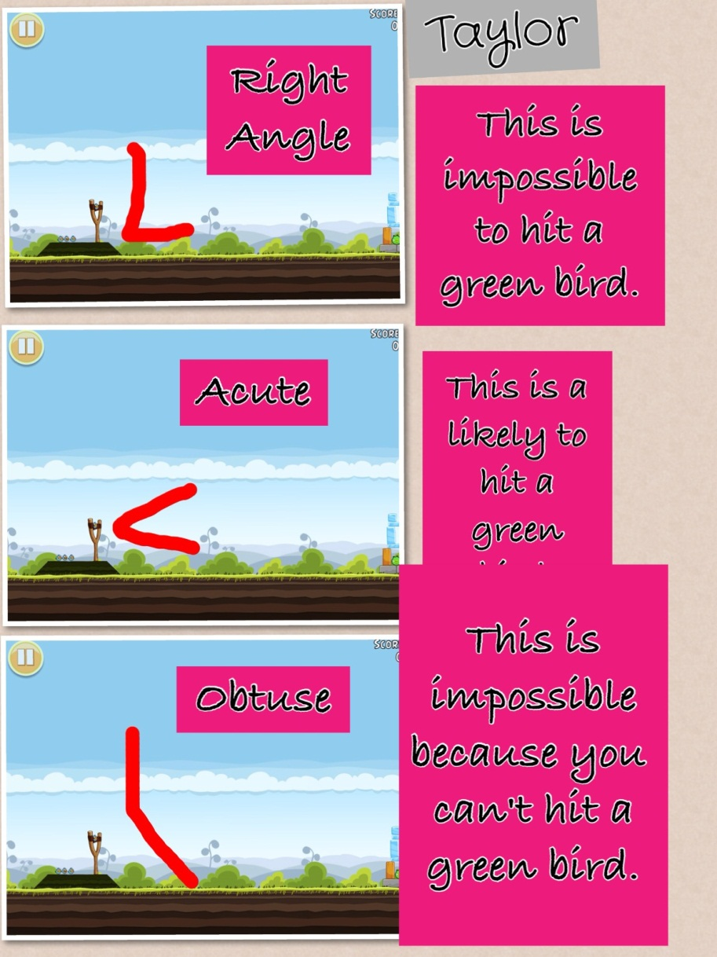
Types of angles (Acute, Right & Obtuse).
Probability / Chance words.
PicCollage
‘iPad Games as a stimulus’ – M. Patterson

Slide 4
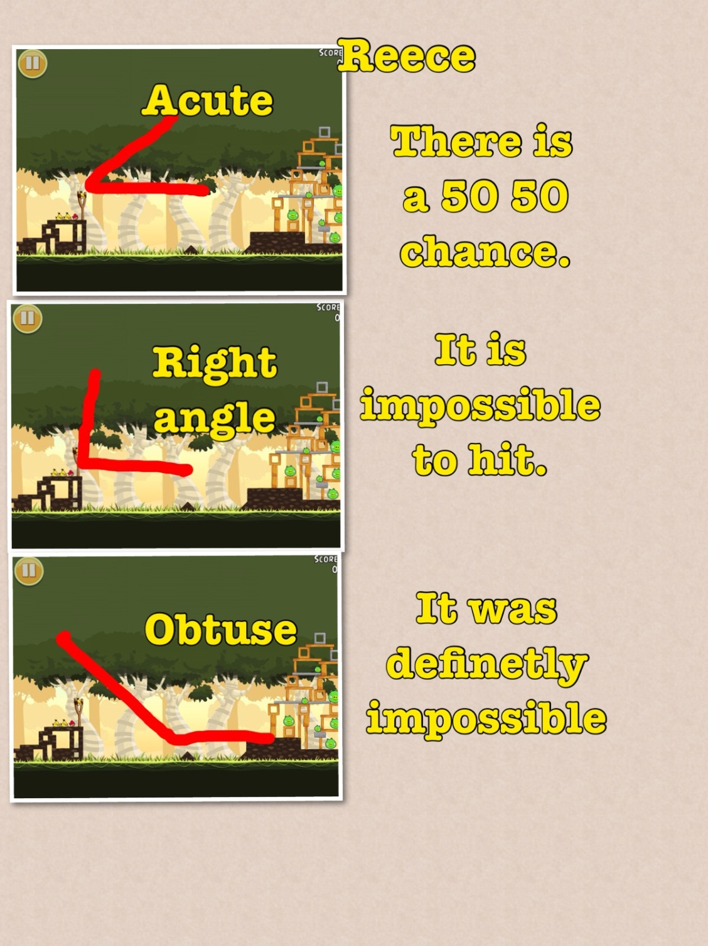
Using the iPad app
'Socrative' we answered
the QCA questions again
hoping to show improvement in our understanding.
Our Autumn Term QCA test results showed 30% of the class had been successful in answering the question correctly.
After our 'Angry Birds' lesson 70% of us were successful in answering the question correctly (90% answered 1 of the two questions correctly)
Socrative
‘iPad Games as a stimulus’ – M. Patterson

Slide 5
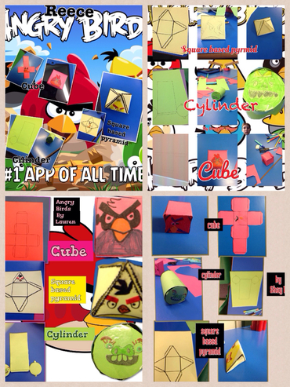
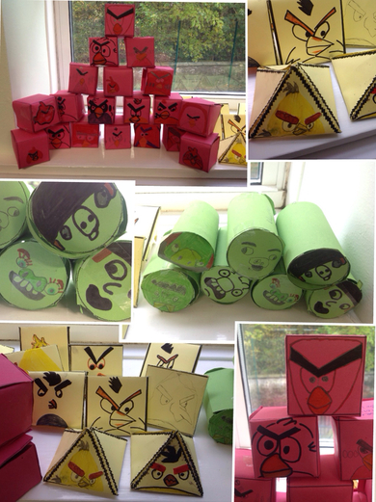
PicCollage
3D Shapes, Net s and their properties:
‘iPad Games as a stimulus’ – M. Patterson

Slide 6
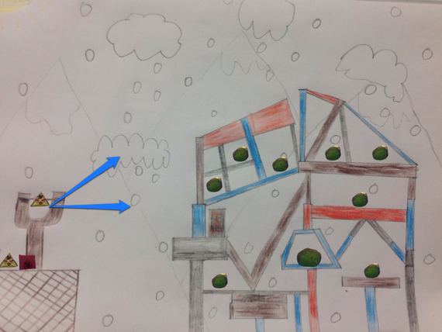
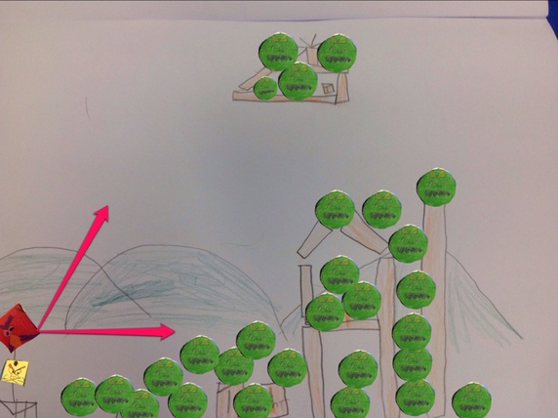
Measuring Angles.
Children made their own Angry Bird levels using the characters they created in the previous lesson.
PicCollage
‘iPad Games as a stimulus’ – M. Patterson

Slide 7
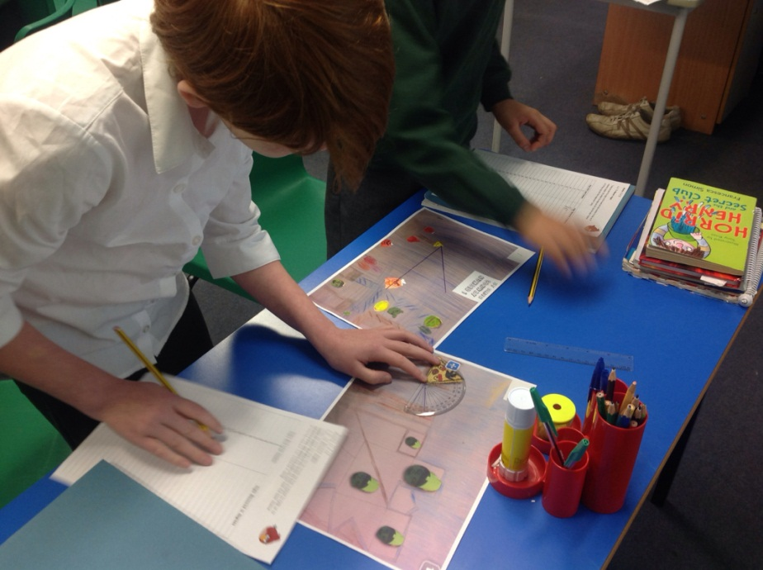
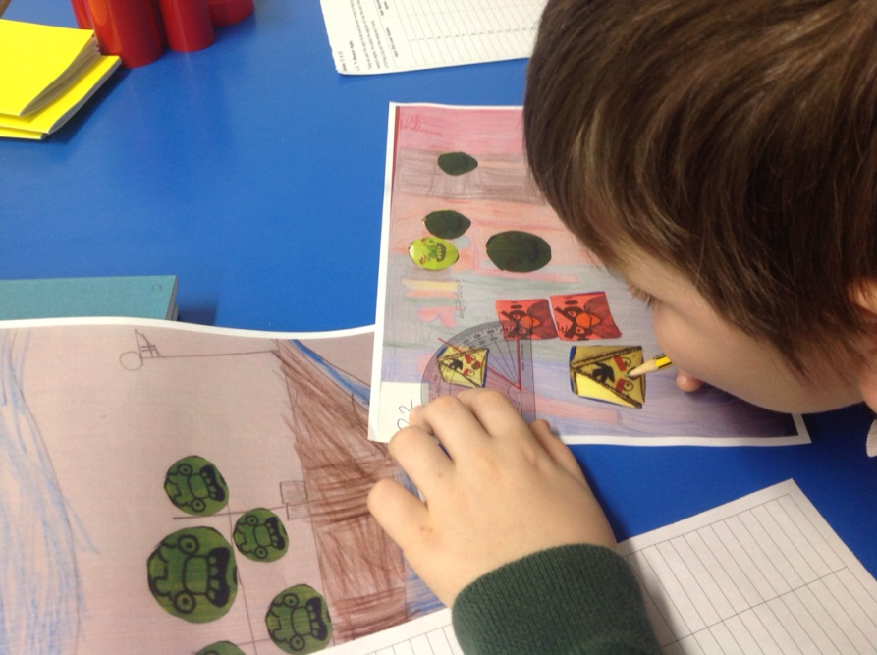
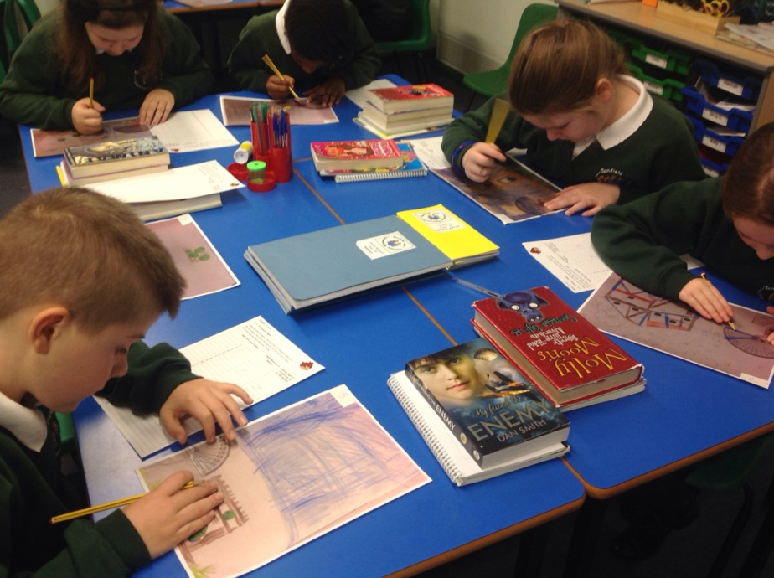
Measuring Angles
Children enjoyed measuring the angles from the Angry Birds levels they had created themselves.
‘iPad Games as a stimulus’ – M. Patterson

Slide 8
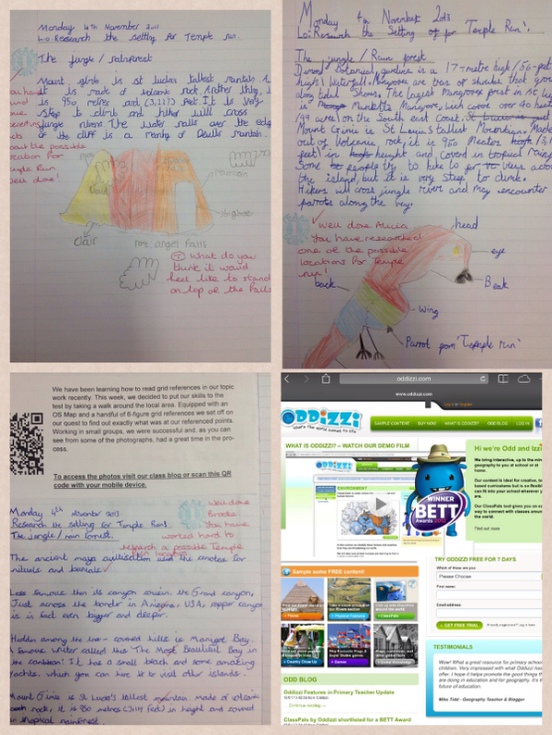
Temple Run 2
We played on the iPad game ‘Temple Run 2’, paying attention to the game’s setting.
After deciding that the game took place in a temple in a jungle, we used the award winning website
www.oddizzi.com
To research jungles / temples around the world and complete a facts page.
‘iPad Games as a stimulus’ – M. Patterson

Slide 9
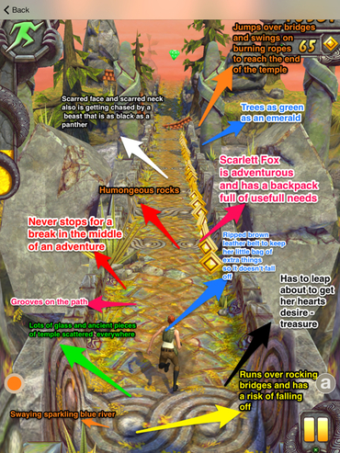
Skitch
To prepare for writing our own adventure story we returned to the game to profile the main character and revisit the setting.
We used skitch to record our ideas!
‘iPad Games as a stimulus’ – M. Patterson

Slide 10
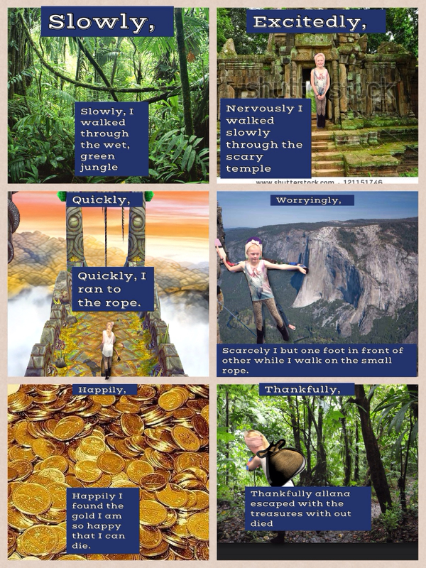
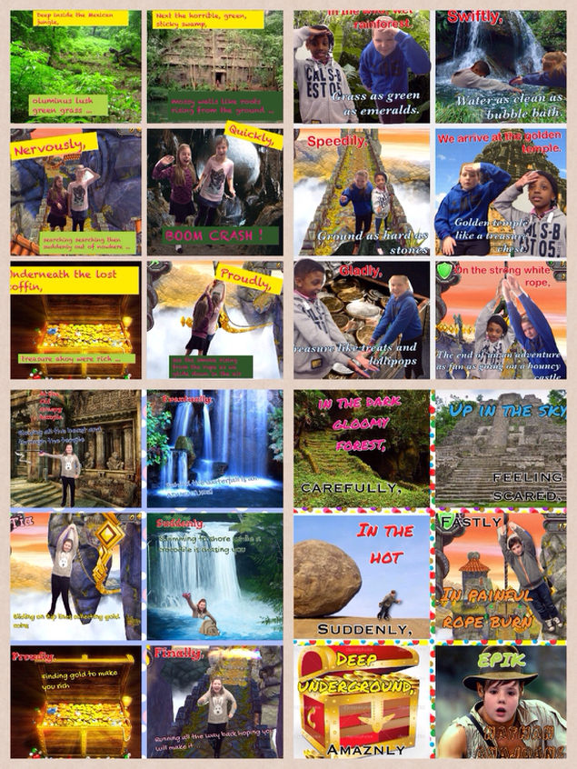
We then planned our own Temple Run themed adventure stories using our knowledge or the character, setting and problems that may be faced.
PicCollage
‘iPad Games as a stimulus’ – M. Patterson

Slide 11
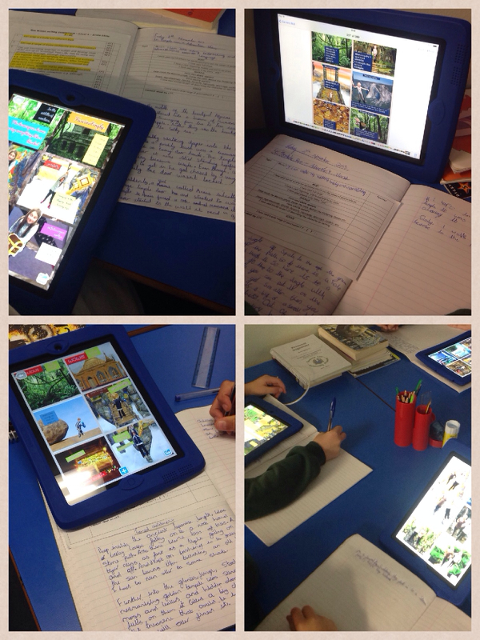
Our work throughout the work came together with a final piece of writing in the form of our very own adventure story.
‘iPad Games as a stimulus’ – M. Patterson

Slide 12
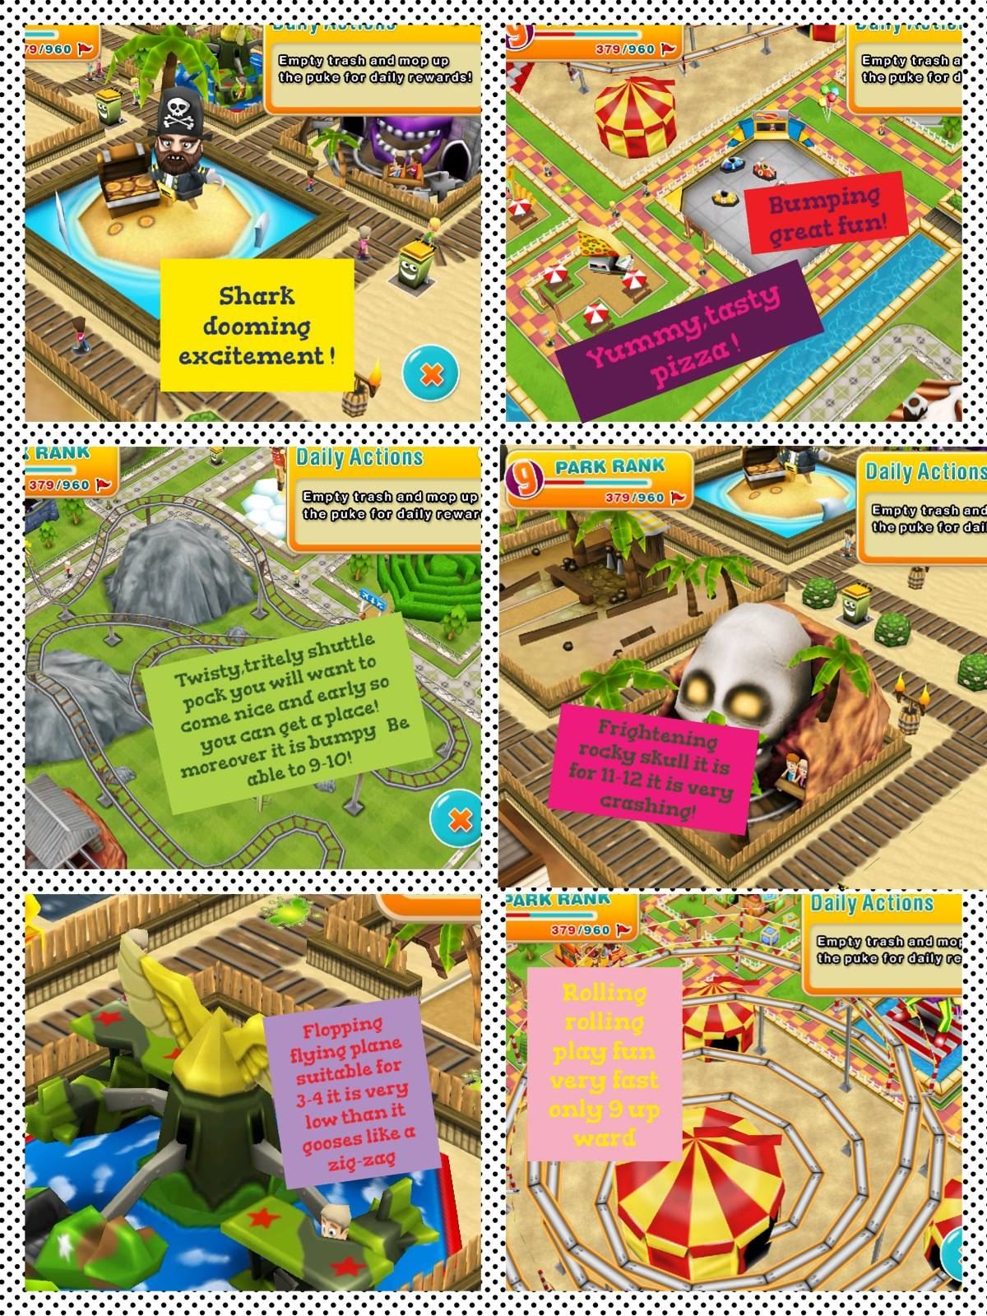
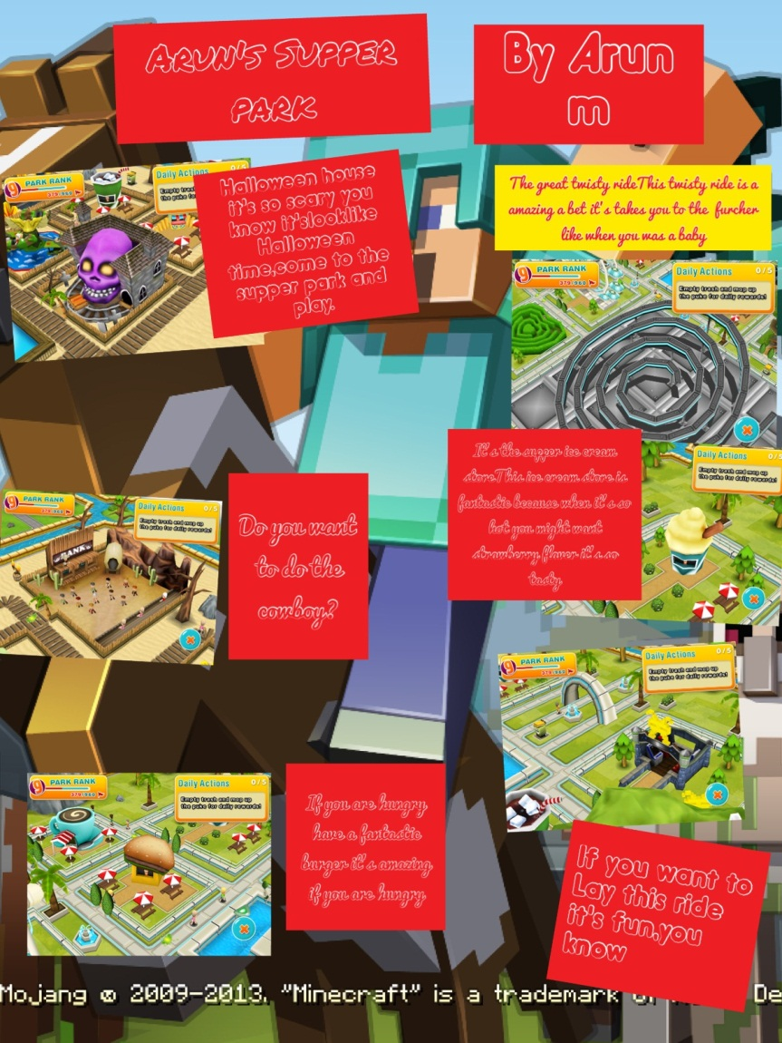
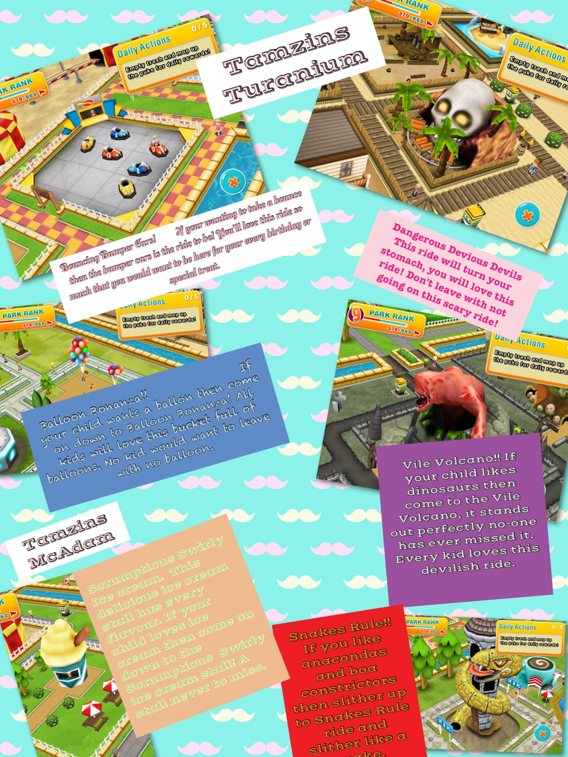
Theme Park
PicCollage
Using the game, we went on a virtual visit to a theme park before creating posters showing our favourite parts of the visit.
‘iPad Games as a stimulus’ – M. Patterson

Slide 13
PicCollage
‘iPad Games as a stimulus’ – M. Patterson

Slide 14
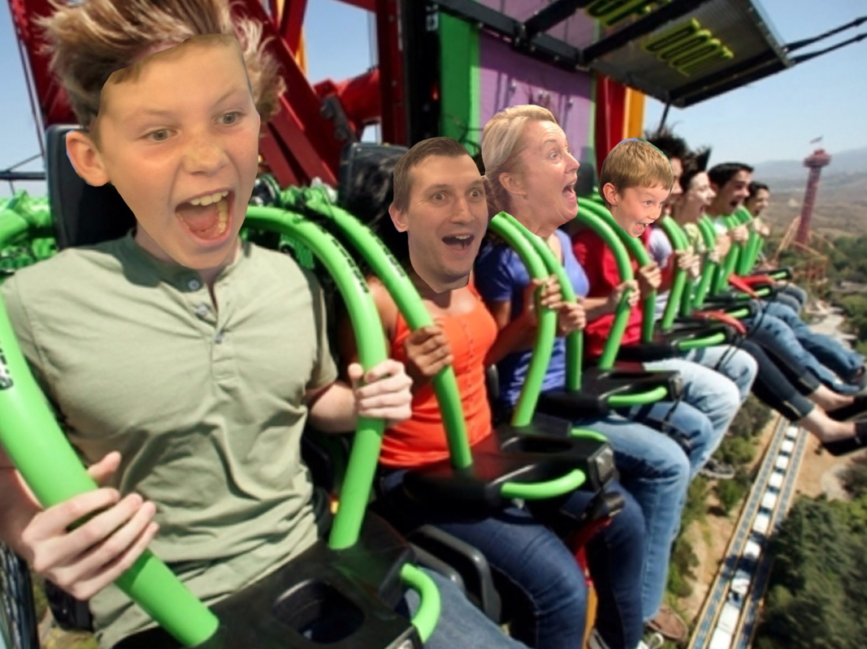
Children then created their own adverts, persuading others to visit their theme park using iMovie. Adverts included images edited in PicCollage.
PicCollage
iMovie
Examples of the adverts at class blog:
5tanfieldlea.weebly.com
‘iPad Games as a stimulus’ – M. Patterson

Slide 15
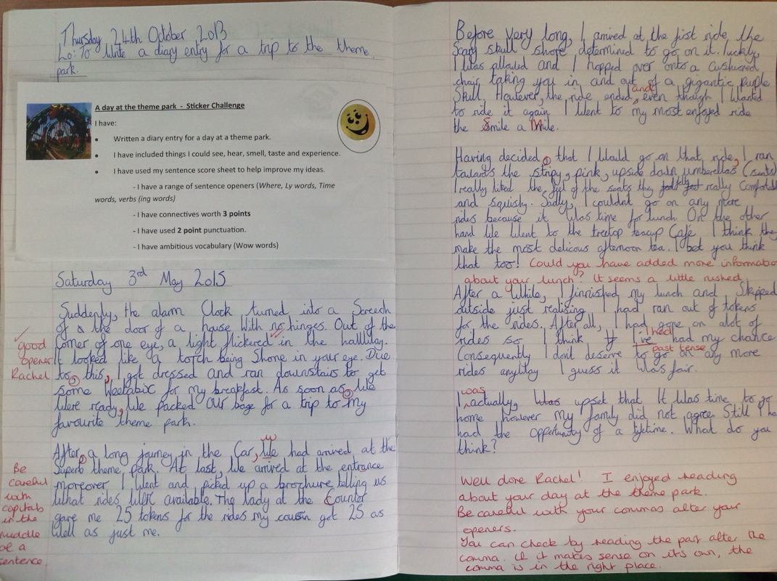
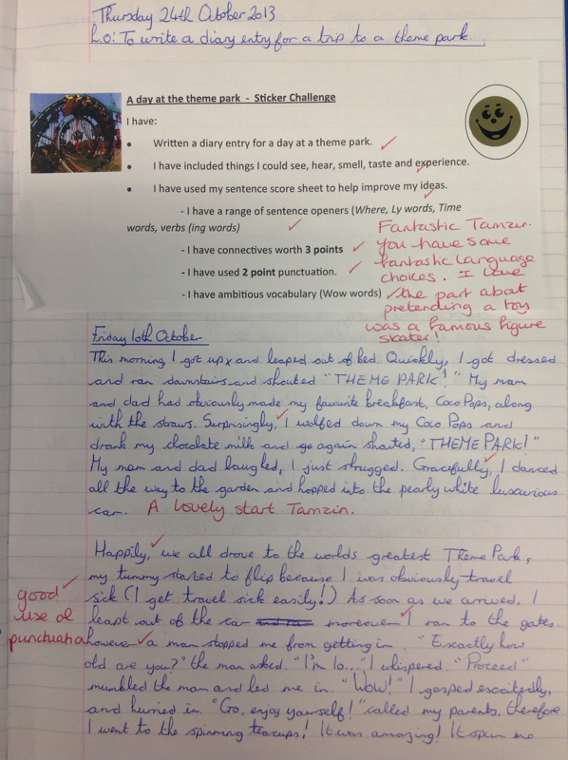
After a lesson looking at up-levelling sentences (with a theme park erm … theme) we wrote recounts of a trip to a theme park.
‘iPad Games as a stimulus’ – M. Patterson

Slide 16
Comparing the work produced at the end of the ‘Theme Park’ week, with work earlier in the term, produced a positive comparison.
‘iPad Games as a stimulus’ – M. Patterson

Slide 17
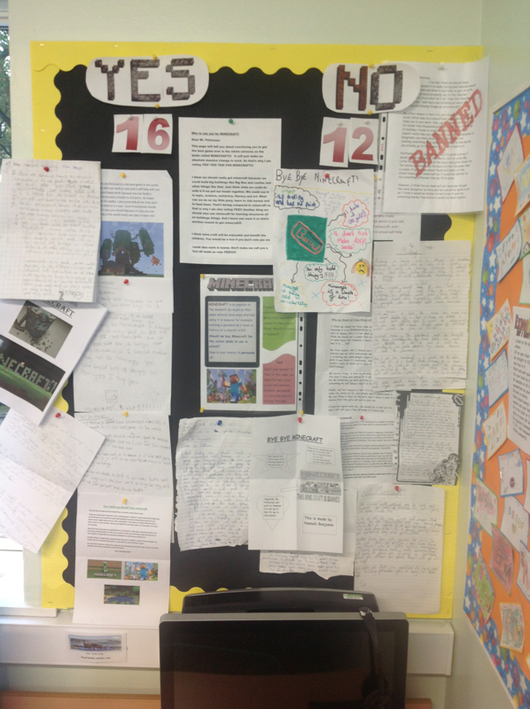
Digging style
Minecraft
AND
<<< All of this
Completed out of school, in the children’s own time.
Minecraft, although not played in class (yet) has generated discussion and written work beyond the class room.
‘iPad Games as a stimulus’ – M. Patterson

Slide 18
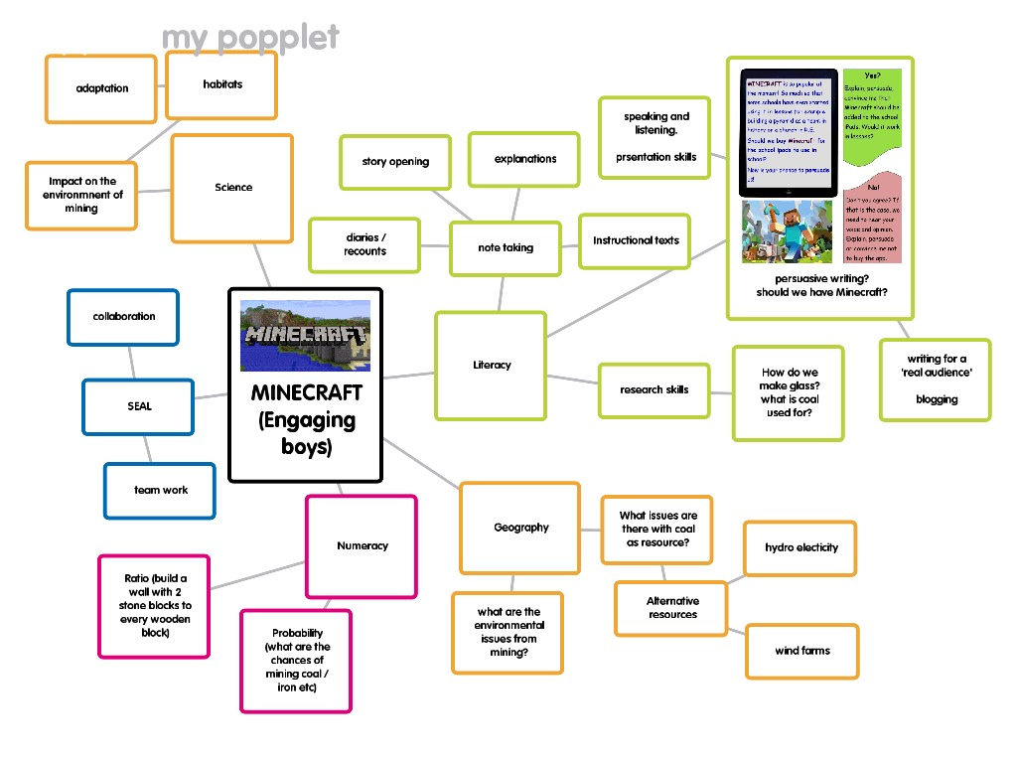
The potential of computer games in the classroom.
‘iPad Games as a stimulus’ – M. Patterson

Slide 19
iPads in Education
Matt Patterson:
Class blog:
5tanfieldlea.weebly.com
(examples & ideas under ‘Curriculum: iPads in Education)
Twitter:
@MattPEducation (blog updates tweeted +more)
Email:
m.patterson100@durhamlearning.net
Angry Birds
PicCollage
Temple Run 2
Socrative
Theme Park
Skitch
Minecraft
iMovie
‘iPad Games as a stimulus’ – M. Patterson

Slide 20
iPads in Education
Matt Patterson:
Class blog:
5tanfieldlea.weebly.com
(examples & ideas under ‘Curriculum: iPads in Education)

